Slide 1
Gluconeogenesis and the Pentose Phosphate Shunt

Slide 2
Learning Objectives
Understand the function of the pentose phosphate shunt and why NADPH generation is important.
Describe the key steps by which gluconeogenesis is controlled by protein phosphorylation and by allosteric control.
Explain how transcriptional changes can alter gluconeogenesis in response to insulin and cortisol.
Explain how the cell ensures that gluconeogenesis and glycolysis do not occur simultaneously.
Understand how, in chronic fasting other tissues provide substrates for gluconeogenesis to the liver.

Slide 3
Pentose Phosphate Shunt
Energetically expensive
Generates:
Ribose sugars for nucleotides
Important in Rapidly Dividing Cells which need nucleotides
Bone marrow, skin, epithelial cells of GI
NADPH
Needed for FA biosynthesis
Also important in cells that make a lot of lipid
Mainly adipose and liver
NADPH is an Antioxidant
Important for blood cells

Slide 4
Regulation of PPP Entry
First enzyme is the rate limiting and irreversible step
Glucose-6-Phosphate Dehydrogenase
Activated by its two substrates
NADP
Glucose-6-Phosphate
Inhibited by high levels of NADH

Slide 5
Fates of Glucose-6-Phosphate
Glycogenesis
Pentose Phosphate Pathway
GS
Glucose-6-Phosphate
Insulin/Glucagon
PFK1
Citrate
AMP/ATP
F26BP
Insulin/Glucagon
G6PDH
NADP/NADPH
Glucose-6-Phosphate

Slide 6
Gluconeogenesis
During exercise
During Amino Acid Breakdown

Slide 7
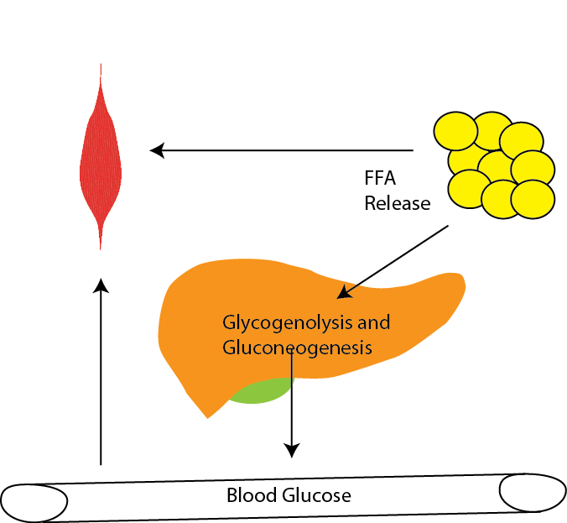
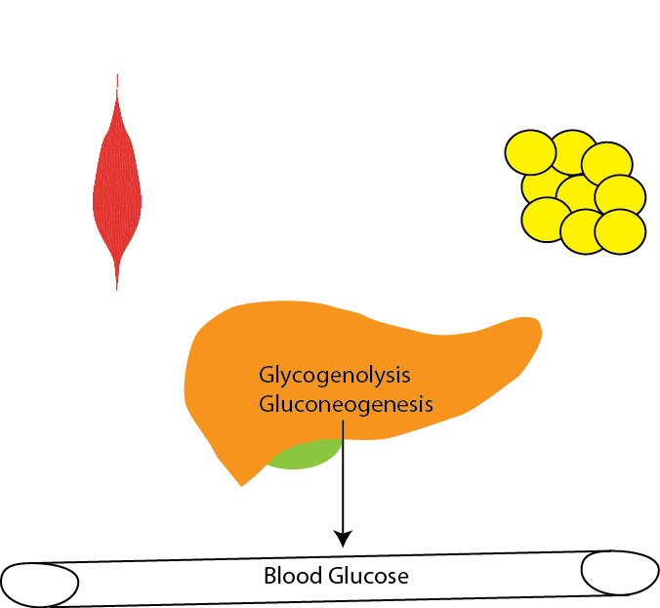
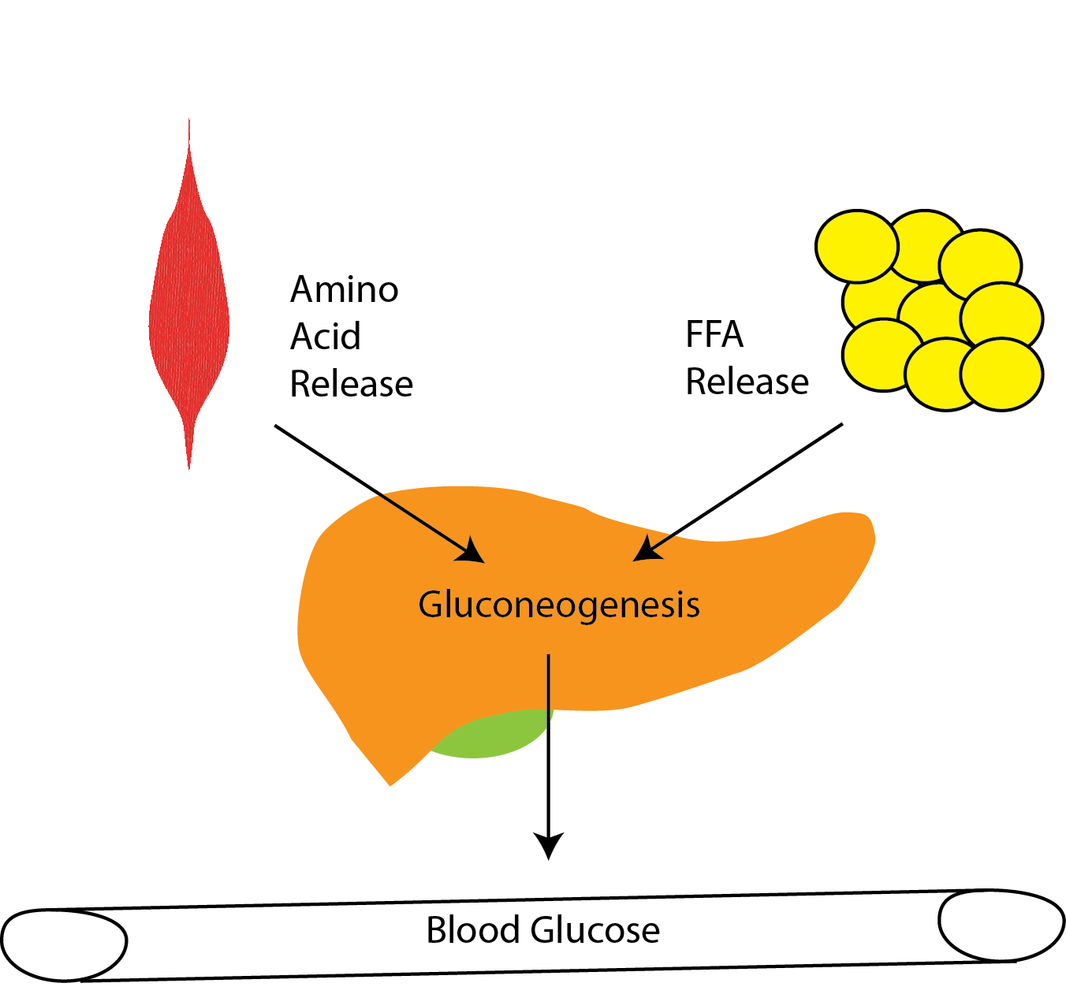
Gluconeogenesis Can Be Activated by Hormones
Adrenaline
Glucagon
Cortisol
What are the physiological reasons these hormones have different actions on fat and muscle different tissues ?

Slide 8
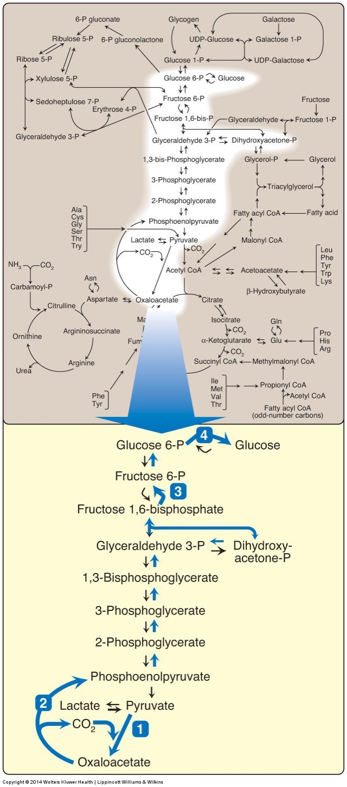
The gluconeogenic pathway
Very similar to glycolysis
Three big differences
Glucose-6-Phosphatase instead of reversed Glucokinase
Fructose 1,6 Bisphosphatase instead of reversed PFK1
OAA -> Pyruvate (skips pyruvate kinase)
Glycolysis was PEP -> Pyruvate

Slide 9
Regulation of Gluconeogensis
TCA Cycle

Slide 10
Phosphoenolpyruvate Carboxykinase
First committed and rate limiting step
PEPCK not regulated allosterically
Insulin regulates transcriptionally (will discuss later)

Slide 11
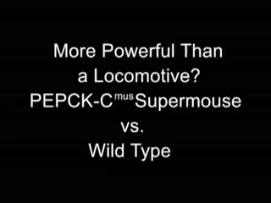
Muscle PEPCK Mouse
A transgenic mouse that overexpresses PEPCK has been dubbed the ”supermouse”
7-10x more active
Can run very very long distances (20m/min for 6h)
Many more mitochondria
Very efficient at using lipid as fuel for exercise
Why do you think this is the case?

Slide 12
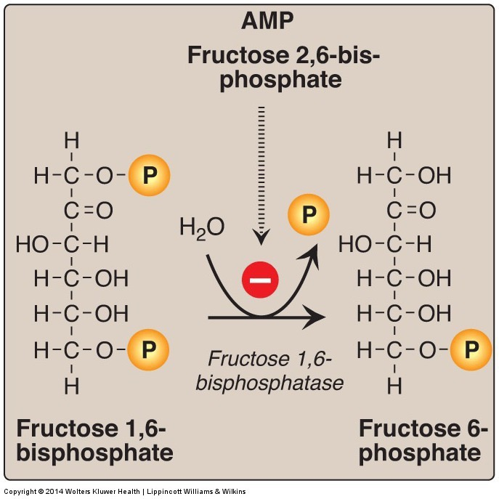
Fructose bisphosphatase 1 reverses PFK1
Inhibited by
F26BP
AMP

Slide 13
Effects of Fructose 2,6 bisphosphate on PFK1/FBPase
PFK1 Activity
FBPase Activity

Slide 14
Regulation by Glucagon/Epinephrine
Talk about what would happen to this activity when glucagon/PKA inactivates PFK2

Slide 15
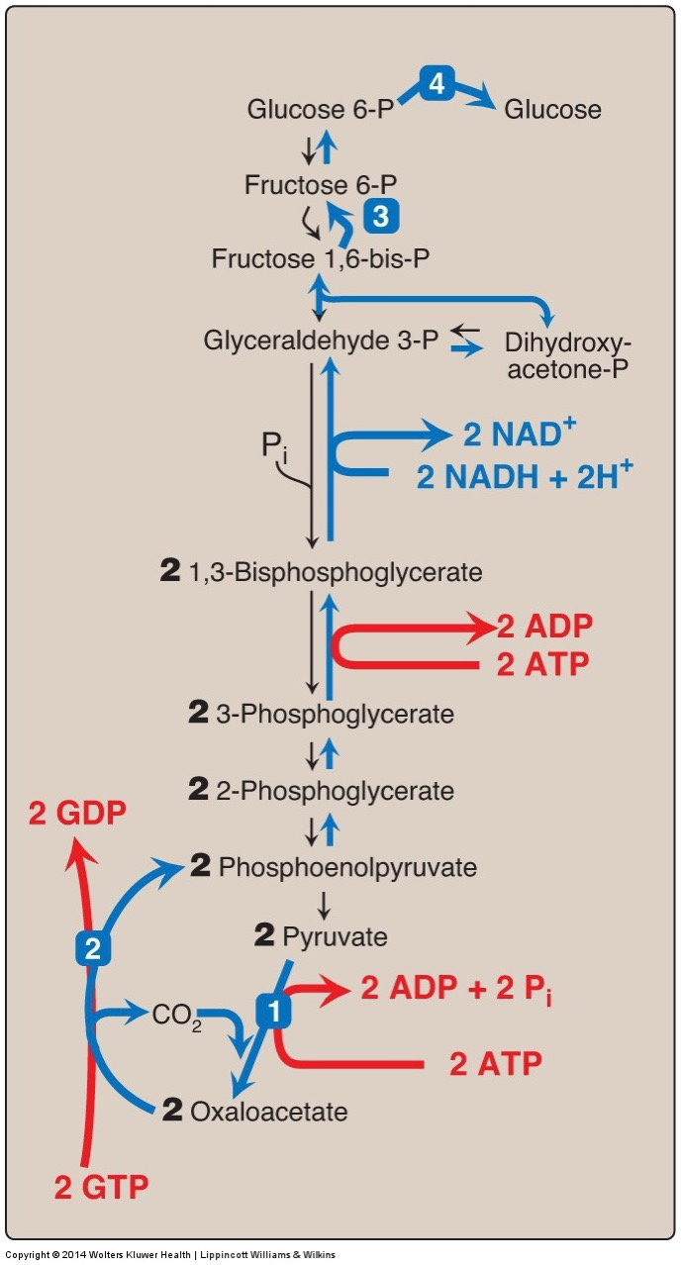
Gluconeogenesis is Expensive
Glycolysis +8 ATP
Glycolysis, Pyruvate Oxidation, ETC +36 ATP
Gluconeogenesis -12 ATP
-6 ATP
-2 NADH (x3 = -6 ATP)
Notes:
Glycolysis followed by gluconeoegenesis is net energy costly, therefore never want both at the same time

Slide 16
Co-ordinate control of gluconeogenesis and glycolysis
 | Glycolysis | Gluconeogenesis
Activity of Glucokinase | High (Glucose High) | Low (Glucose Low)
Activity of Glucose-6-Phosphatase | Low (Transcriptional) | High (Transcriptional)
Activity of Phosphofructokinase | High (via F26BP high/AMP) | Low (via F26BP low/ATP/Citrate)
Phosphorylation of PFK2 | Dephosphorylated (Active) | Phosphorylated (Inactive)
Activity of FBPase | Low (via F26BP high/AMP/Citrate) | High (via F26BP low)
Phosphorylation of Pyruvate Kinase | Dephosphorylated (Active) | Phosphorylated (Inactive)
Activity of Pyruvate Kinase | High (AMP/F16BP) | Low (Alanine)
Activity of Pyruvate Carboxylase | Low | High (Acetyl-CoA)
Activity of PEPCK | Low (Transcriptional) | High (Transcriptional)

Slide 17
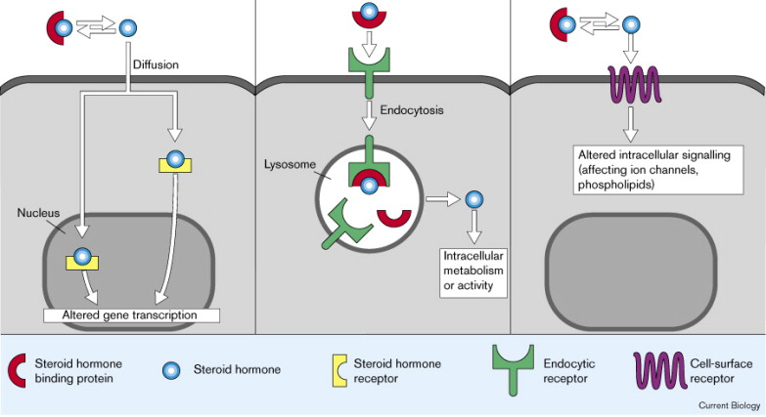
Nuclear Hormone Receptors
Insulin
Glucagon
Epinephrine
Cortisol

Slide 18
Cortisol Effects on Gluconeogenesis
Transactivates (increases protein levels)
G6Pase
PEPCK

Slide 19
Insulin Effects on Gluconeogenesis
Thought to be mainly transcriptional (via a transcription factor FOXO)
Induces the expression of
Glucokinase
Represses
Glucose-6-Phosphatase
PEPCK
Promotes the dephosphorylation of PFK2 and Pyruvate Kinase
What would that do?
Promotes glycogenesis, diverts G6P away from glucose

Slide 20
Learning Objectives
Understand the function of the pentose phosphate shunt and why NADPH generation is important.
Describe the key steps by which gluconeogenesis is controlled by protein phosphorylation and by allosteric control.
Explain how transcriptional changes can alter gluconeogenesis in response to insulin and cortisol.
Explain how the cell ensures that gluconeogenesis and glycolysis do not occur simultaneously.
Understand how, in chronic fasting other tissues provide substrates for gluconeogenesis to the liver.

